Slide 1



Integrated Program in Business Analytics
Airline Flight Delay Prediction Using Machine Learning Models
IPBA Batch 14 - Group F
Team members:
Akanksha Singh
Tejashree Gaikar
Suraj Jadhav
Shubham Tewari
Nalin Manchanda

Slide 2
Agenda
Business Problem and Objectives
Data Overview
Data Preparation and Pre-processing
Exploratory Data Analysis
Feature Importance
Model Development and Validations
Business Recommendation and Next Steps
Appendix

Slide 3
Business Problem and Objectives
Business Problem
Prediction of Flight delays from three particular airports in New York City on the basis of the historical data provided for the year 2013.
Objective
Analysing the scheduled flights that departed from New York city airports.
Implemented supervised machine learning models to predict flight arrival delays.
Notes:
AK

Slide 4
METHODOLOGY
S(Situation)
T(Task)
A(Action)
R(Result)
We have data for 16 airlines which are originating from three major airports of New York. This data shows the arrival time and departure time of the flights from these airports.
The major task here is to predict the arrival delays for these carriers on the basis of the historical data provided.
Post analysing the raw data, we performed EDA to categorize the data as per our requirements.
After which we used multiple ML models to finalize the one with highest accuracy.
After performing the required analysis we are able to predict the arrival delay for the flights on the basis of the airports with highest accuracy.
Notes:
AK

Slide 5
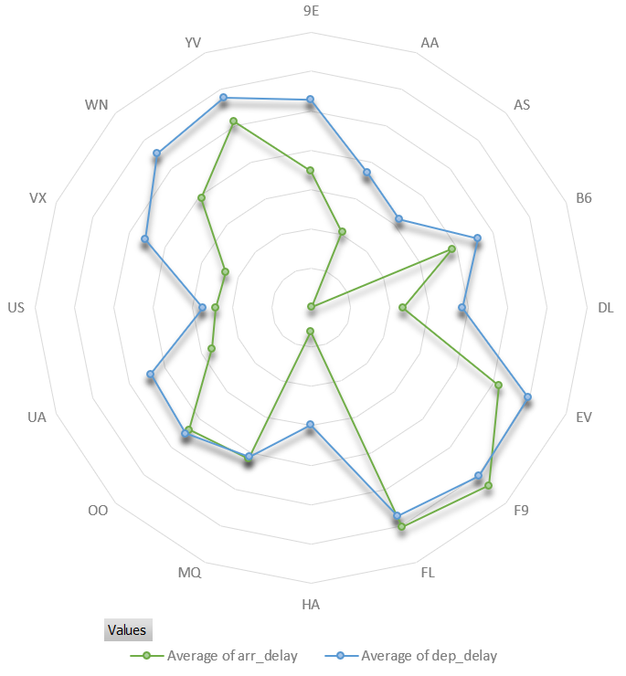
Executive Summary
The purpose of this study is to gain insights with regards to flight delays and understand the patterns and trends associated with them.
Historical data of 3 major airports of New York has been reviewed for 1 year. There are 3 lakh rows which depict the no. of flights that has taken off from these three airports.
The dataset used for this analysis contains information on various attributes related to flight delays, such as departure and arrival times, airline carriers, airports, origin, destinations, distance, and air time.
EDA techniques, including data cleaning, visualization, and statistical analysis, were performed to examine the dataset and draw meaningful conclusions.
Here we are trying to analyze the delays in the flights with respect to the arrival from the 3 major airports. We have achieved an accuracy of approx 70% where we can predict whether the flight will be delayed or not at the time of arrival.
Notes:
AK

Slide 6
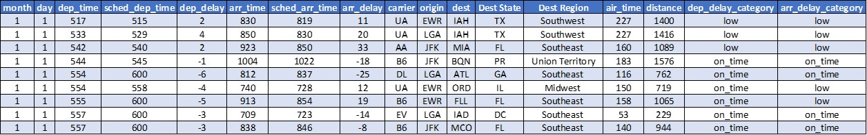
Data Overview
The dataset is for flights that departed from 3 airports in New York City (i.e. John F. Kennedy Airport, LaGuardia Airport and Newark Liberty International Airport) in the year 2013.
FEATURES
TIME FRAME
Categorical | Numerical
Carrier | Departure delay
Destination | Arrival delay
Origin | Arrival time
Destination Region | Air time
 | Distance
12 months data from 1/1/2013 to 31/12/2013
DATASET SNAPSHOT
Data Set Source - 'https://vincentarelbundock.github.io/Rdatasets/doc/nycflights13/flights.html'
Notes:
AK

Slide 7
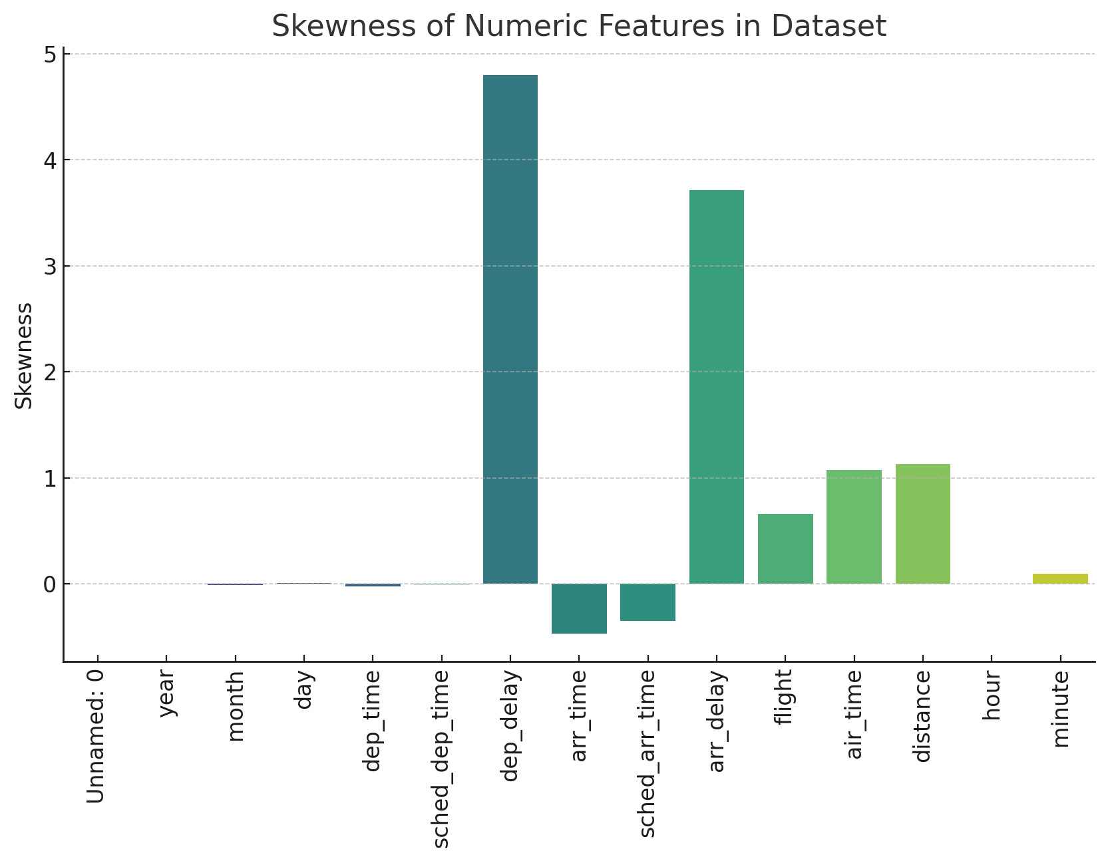
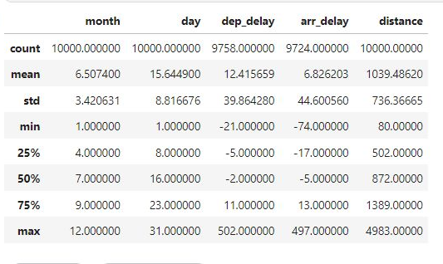
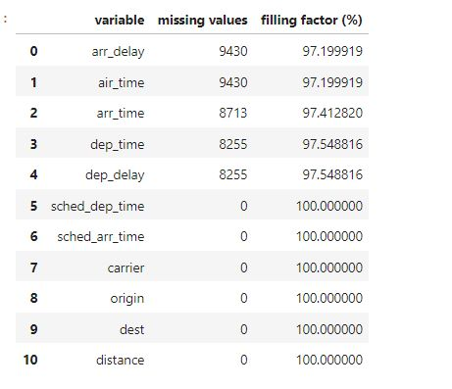
Data Preparation and Pre-processing
Checked the data set for number formatting, missing values, outliers, feature selection
NUMERICAL FEATURE INSIGHTS
MISSING VALUES
The data contained almost 3% of the total missing values. Since the missing data was not much we have eliminated it from the dataset.
The maximum missing value was for Arrival Delay, which we assumed to be the flights which were on time.
Data Set Source - 'https://vincentarelbundock.github.io/Rdatasets/doc/nycflights13/flights.html'
Notes:
AK - Before we create a skewness graph, it's important to note that skewness can only be calculated for numerical columns. Therefore, we will exclude the non-numerical columns in the dataset. Let's proceed to calculate the skewness and create the graph.
Here is the skewness graph for the numeric features in the dataset.
In the context of statistics, skewness is a measure of the asymmetry of the probability distribution of a real-valued random variable about its mean. In simpler terms, skewness tells you the amount and direction of skew (departure from horizontal symmetry). The skewness value can be positive or negative, or undefined.
In this dataset, most features have positive skewness, meaning the right tail of the distribution is longer or fatter than the left. A notable exception is the 'hour' feature, which has near-zero skewness, indicating a more symmetric distribution. Features like 'dep_delay' and 'arr_delay' exhibit high positive skewness, suggesting many flights have small delays but a few have large delays.

Slide 8
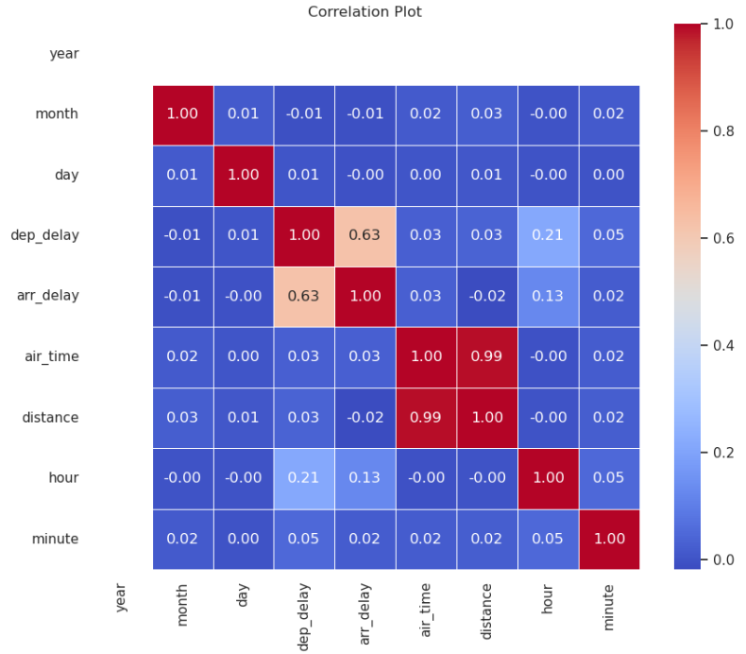
Exploratory Data Analysis- Correlation Matrix
Key Insights:
In classification models, a confusion matrix can be visualized as a heatmap to better understand the distribution of true positives, false positives, true negatives, and false negatives
Departure delay is positively correlated with arrival delay.
Air time is strongly correlated with distance
Least correlation is between arrival delay and distance
Notes:
Suraj

Slide 9
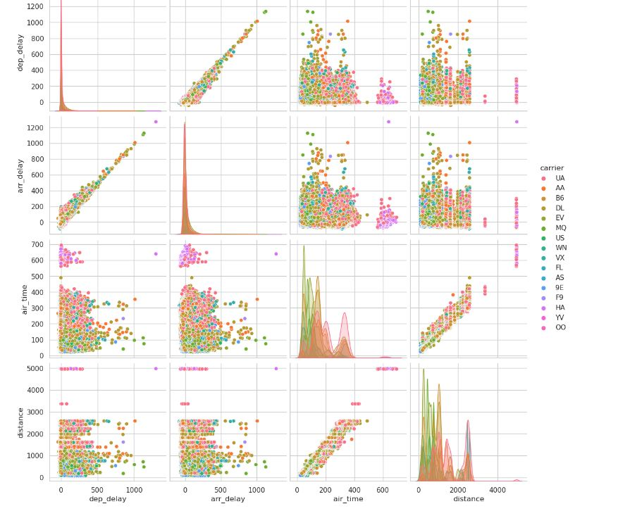
Exploratory Data Analysis- Multivariate
Key Insights:
In this pair plot correlation is represented with respect to carriers in dataset
The most apparent insight from a pair plot is the correlation between variables. Scatterplots show how two variables move concerning each other, which can indicate whether they have a positive, negative, or no correlation
A lack of correlation is represented by scattered points with no clear pattern.
Pair plots are revealing outliers as points that lie far away from the majority of other points in the scatterplots.
Notes:
Suraj

Slide 10
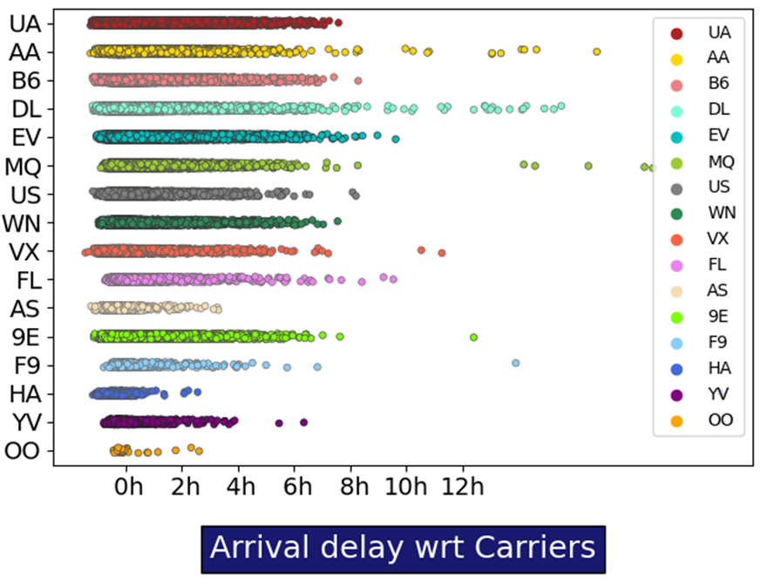
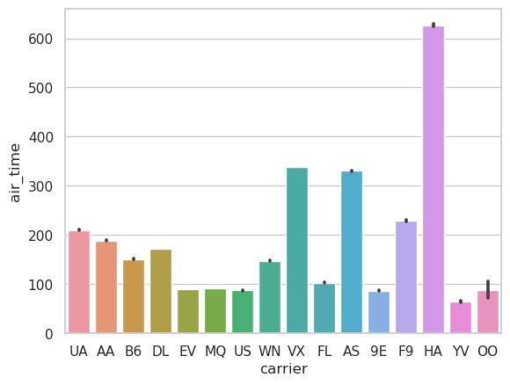
Exploratory Data Analysis- Multivariate
Key Insights:
First plot is representing delay with respect to carriers: larger delay can be seen for HA carrier and MQ for particular flights
HA has the highest air time followed by VX and AS.
Notes:
Suraj

Slide 11
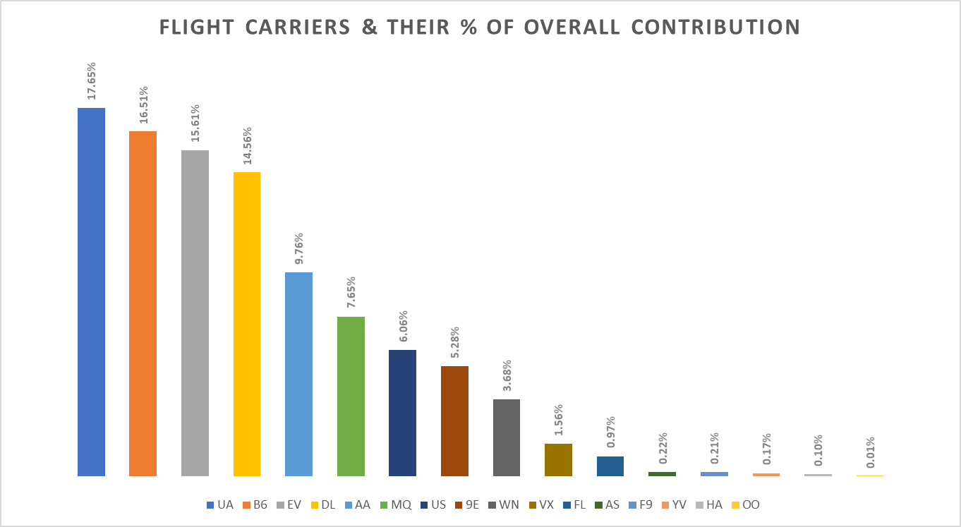
Data Analysis
The adjacent graph shows the analysis between the % share of flight carriers out of the total number of flights.
UA has the highest share with 57,782 flights, B6 has the 2nd highest share with 54,049 flights and EV has the 3rd largest share with 51,108 flights.
OO has the lowest number of flights totalling at 29, followed by HA with 342 and YV with 544 flights across all origins and destinations.
Notes:
Speaker : Nalin

Slide 12



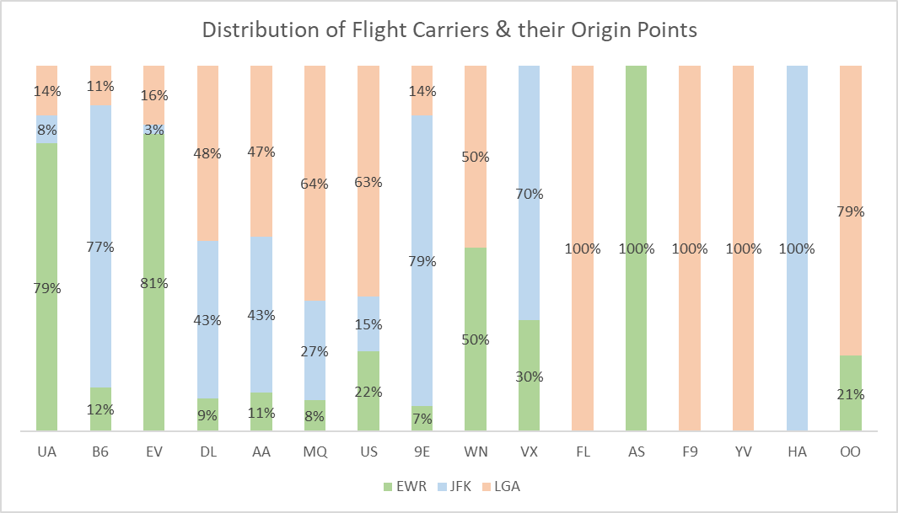
Data Analysis
Predicting flight delays is crucial to improve airline operations and passenger satisfaction. Machine learning models using historical data and real-time information help airlines anticipate delays, allocate resources efficiently, and provide better customer service. Reducing delays saves costs, enhances the aviation system's efficiency, and positively impacts the economy.
Although not all delays can be eliminated, predictive models significantly improve operational efficiency and travel experience, with potential for further advancements in the future.
The adjacent graph shows the distribution of flight carriers and their origin points.
UA, B6 & EV have the top 3 share with the number of flights from the 3 origin locations totalling at 162,939 out of 327,246 flights.
EWR is the busiest origin location with 117,127 flights, 2nd is JFK with 109,079 and LGA with 101,140 flights.
Notes:
Speaker : Nalin

Slide 13
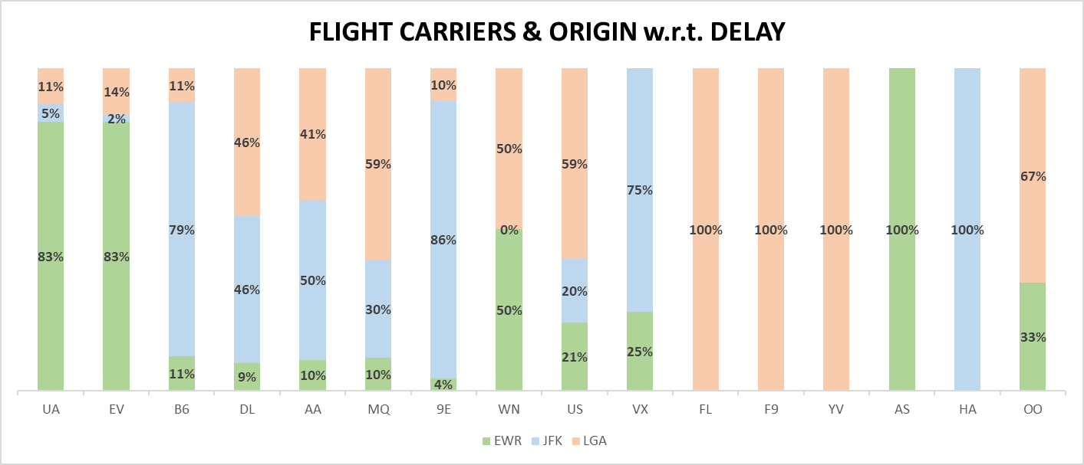
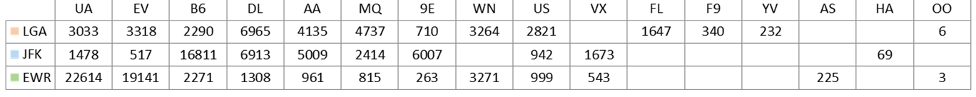
Data Analysis
The adjacent graph shows the analysis between % departure delays w.r.t. the flight carriers and the origin.
As per the flight origin, EWR has the most delays totalling 52,141. 2nd is JFK, with 41,833 flight delays, and lastly, LGA has 33,498 flight delays.
The total number of flight delays from the 3 origin points is 127,745 out of 327,246 total flights.
Giving us an insight of % of flight delay at origin, is 39.02%
Notes:
Speaker : Nalin

Slide 14
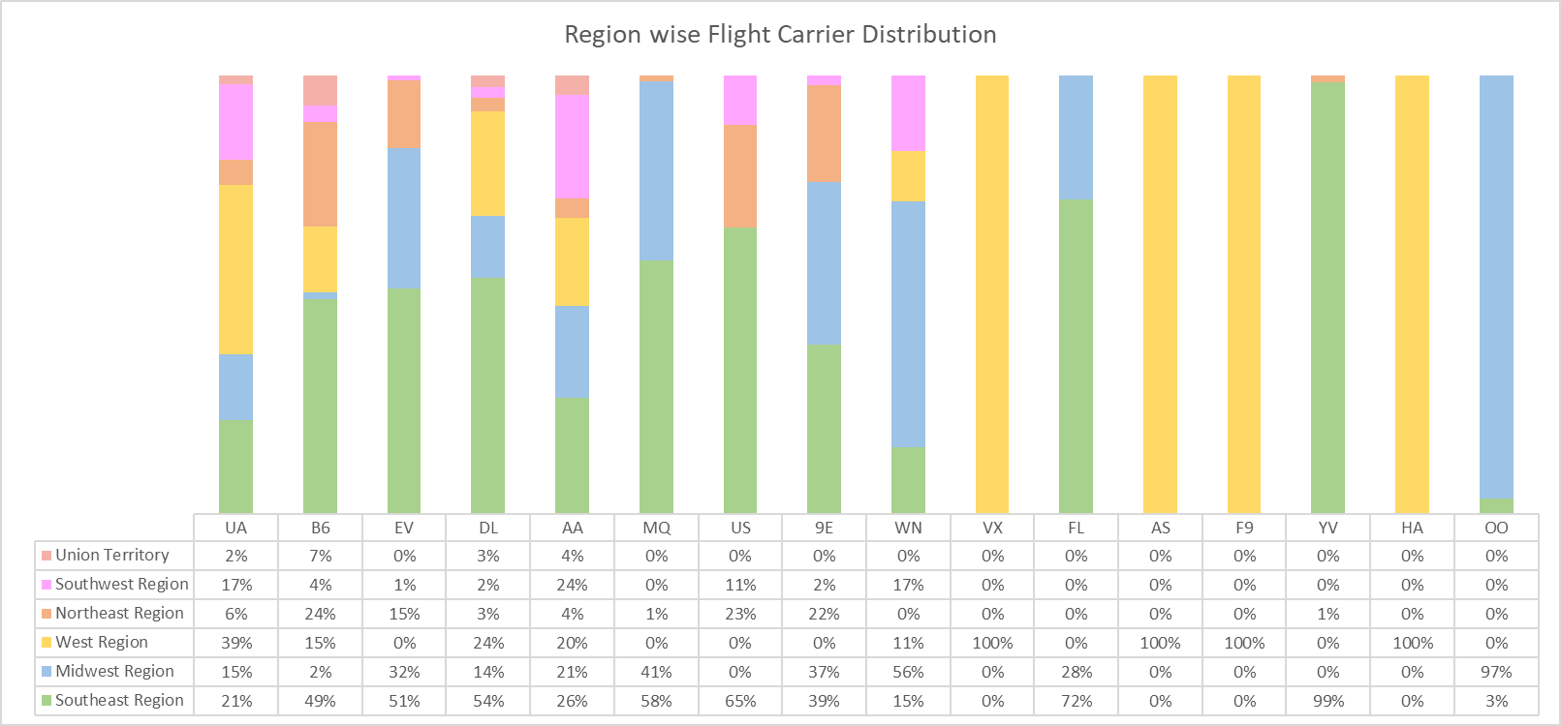
Data Analysis
The adjacent graph shows the analysis between the US regions and the Flight Carrier % distribution.
Southeast Region has the most number of flights 137,850, Midwest Region has the 2nd most number of flights 63,683. West Region comes at 3rd place with 56,487 flights, followed by Northeast Region with 35,694 flights, Southwest Region with 26,095 and Union Territories with 7,537 flights.
Since destination airports were spread across 46/50 States, we have narrowed it down to 6 Regions.
Notes:
Speaker : Shubham

Slide 15
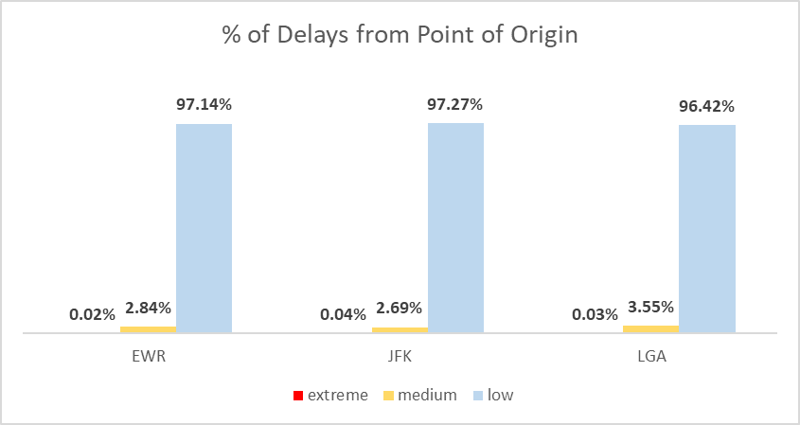
Data Analysis
The adjacent graphical representation shows a breakdown of departure delays from the 3 New York airports, which have been taken as the point of origin for all flights.
The delay has been categorized into 3 types:
low : 0 mins < scheduled departure time <= 180 mins
medium : 181 mins < scheduled departure time <= 650 mins
extreme : scheduled departure time > 650 mins
Notes:
Speaker : Shubham

Slide 16
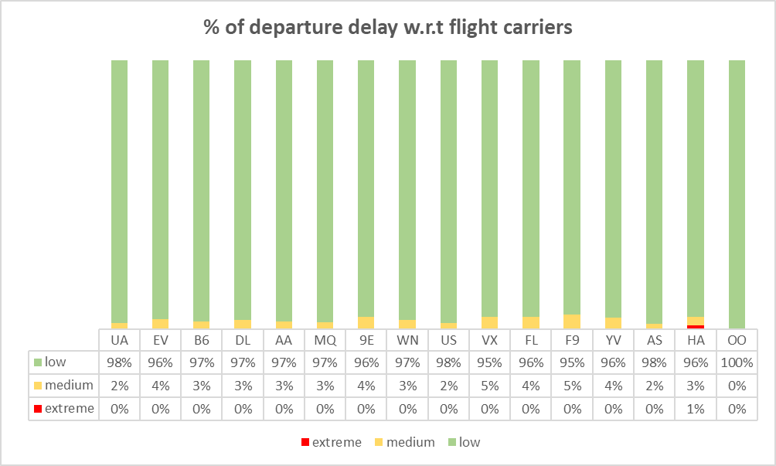
Data Analysis
The graph shows the departure delay categorizations from the 3 origin airports, based on a carrier level break down (16 carriers).
Outliers for the 3 categories are as follows:
low : OO carrier had 100% low departure delays
medium: 5% of all delayed flights of VX and F9 were medium delays
extreme: HA was the only carrier with 1% of delayed flights categorized as extreme
Notes:
Speaker : Shubham

Slide 17
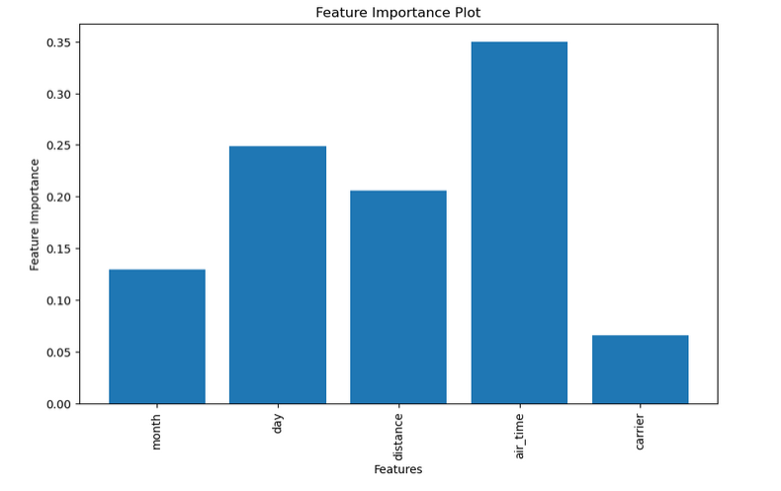
Feature Importance
Feature importance score, helps us to understand which features are most influential in making predictions.
With the help of bar chart we get to know distance and departure delay are important features in model
Departure delay was categorized into category of low, medium and high.
For machine learning model numerical input is required so categorical columns were converted into numerical with Label encoding
Notes:
Speaker : Shubham

Slide 18
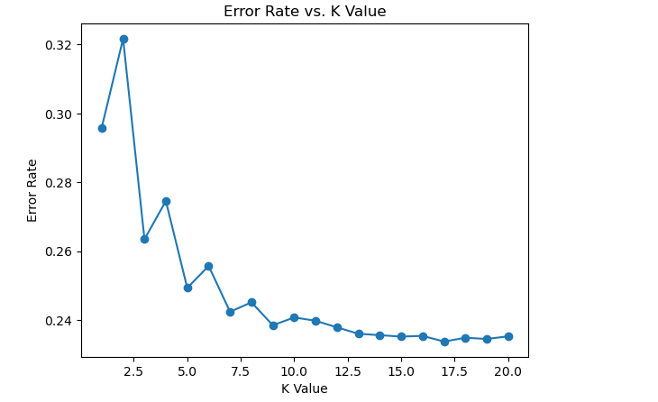
Model Development and Validation
KNN
K-Nearest Neighbors (KNN) is a simple yet powerful non-parametric classification algorithm.
KNN is a non-parametric algorithm, meaning it does not assume any specific underlying data distribution. Instead, it learns from the training data directly, making it versatile and suitable for a wide range of data types and distributions.
Selection for K Value
Model's performance on a separate validation set or through cross-validation to avoid overfitting and select the best K value.
Grid search was performed to find best K-value. From the given chart we get to know k value between 12 to 20 gives less error rate.
Notes:
speaker: tejashree

Slide 19
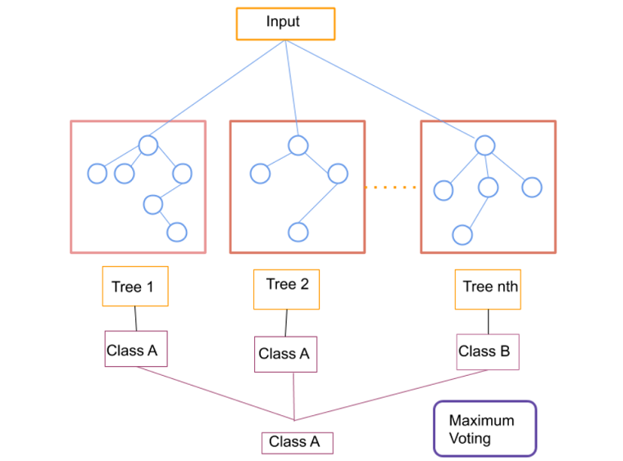
Model Development and Validation
Random Forest :
Random Forest is a powerful and popular ensemble learning method used for classification tasks.
It is known for its high accuracy in predicting both categorical and continuous target variables. By aggregating the predictions from multiple trees, it tends to produce more robust and reliable results compared to individual decision trees.
Grid search was performed for cross-validation to evaluate the model's performance for different n_estimators.
Grid range between 50 to 100 was carried out to evaluate performance of model.
Notes:
speaker: tejashree

Slide 20
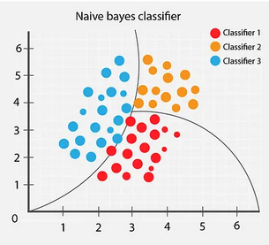
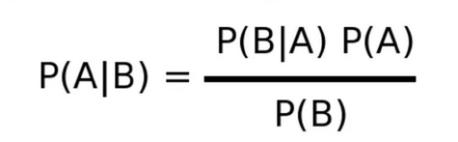
Model Development and Validation
Naive Bayes
Naive Bayes is a simple yet powerful probabilistic classification algorithm that is widely used in various machine learning applications.
Simplicity and Efficiency: It is a simple and easy-to-understand algorithm. It is computationally efficient and can handle large datasets with a relatively small amount of memory, making it well-suited for real-time or online learning scenarios.
Notes:
speaker: tejashree

Slide 21
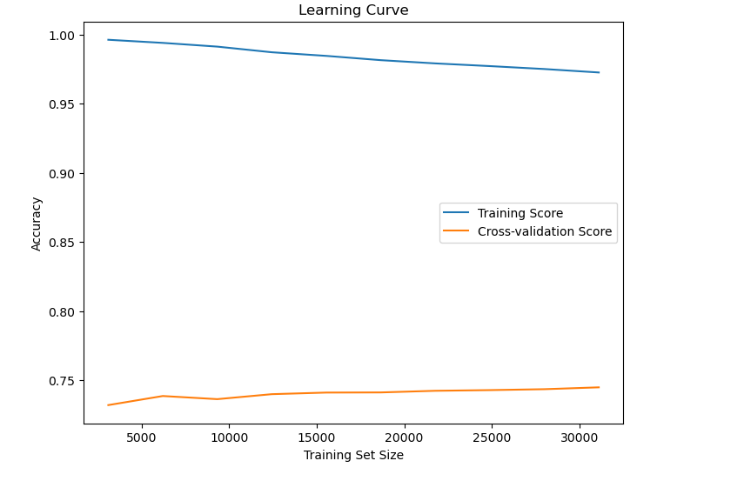
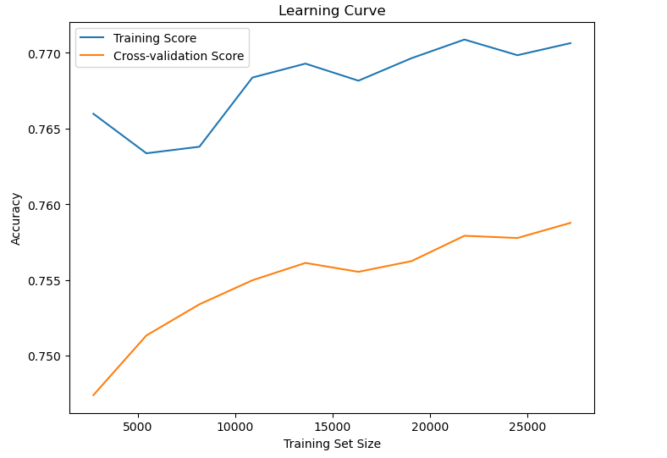
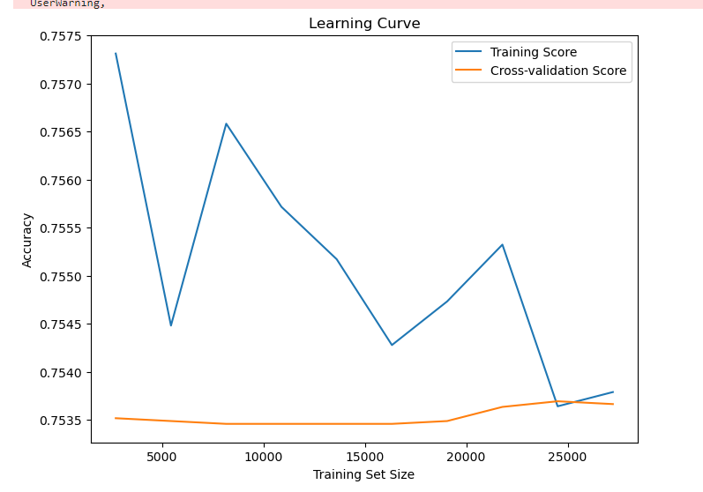
Learning Curves for model
Random Forest
KNN
Naive Bayes
Notes:
speaker: tejashree

Slide 22
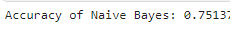
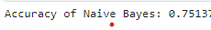
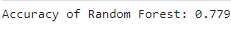
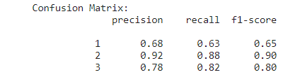
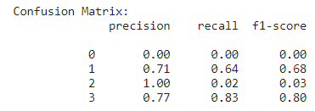
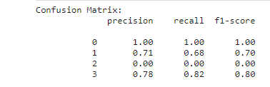
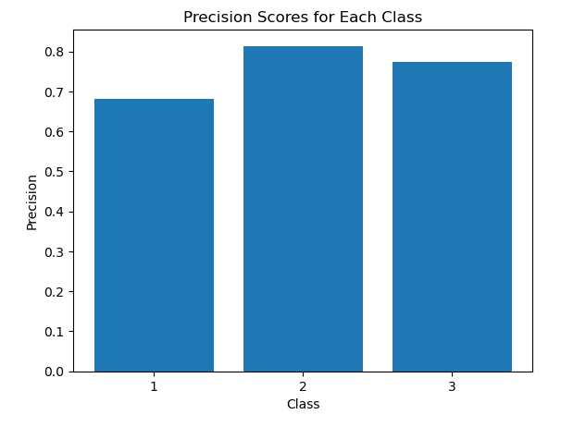
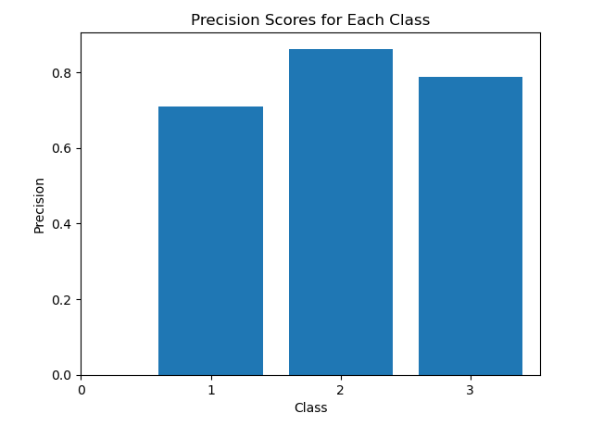
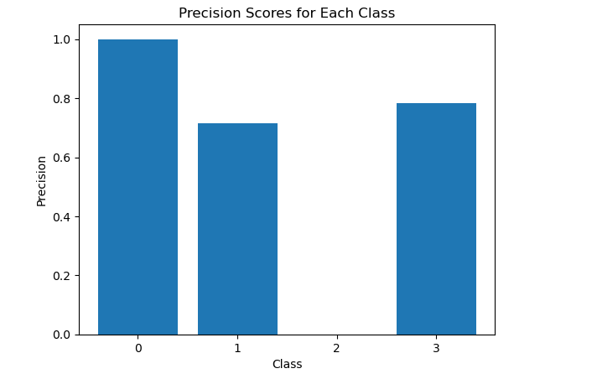
Summary for model Techniques selection
Confusion Matrix
Random Forest
KNN
Naive Bayes
Notes:
speaker: tejashree

Slide 23
Business Recommendation
Based on the delays predicted, we can proactively inform passengers about the potential delay which can help manage the customer’s expectations and to plan their travel better.
Predicting delays can help airlines identify potential maintenance issues in advance, allowing for more effective maintenance and repair scheduling. This can lead to fewer unexpected cancellations and delays due to technical issues.
Precautionary measures should be readily available to promote readiness in case of medical emergencies.
Capacity planning by airlines with regards to season specific footfall can avoid passenger congestion which would eventually reduce chances of chaos.
Airports can utilize flight delay predictions to optimize runway scheduling, gate assignments, and overall airport operations, leading to more efficient use of resources.
Knowing about potential delays can help airlines optimize flight routes and fuel consumption, leading to cost savings and reduced carbon footprint.
Notes:
Nalin

Slide 24
Next Steps
Deployment and Monitoring: Deploy the model into production, ensuring it is integrated correctly with your application or system. Set up monitoring to track the model's performance over time and identify any issues or deviations from expected behavior.
Model Maintenance: Regularly maintain and update the model as needed. Monitor its performance in the real-world environment and make improvements based on user feedback and changes in the data distribution.
Additional data points: Gather data from different sources with different parameters to make a robust models.
Feature Scaling and Normalization: Ensure that the input features are appropriately scaled and normalized to prevent issues with convergence and to improve the neural network's ability to learn.
Model Architecture: Try different neural network architectures, including the number of layers, the number of neurons in each layer, and the activation functions. Consider using techniques like transfer learning if applicable.
Ensemble Methods: You can create an ensemble of neural networks or combine them with other models like Random Forest to improve predictive performance further.
Notes:
Nalin

Slide 25
Q&A
Notes:
Speaker : Shubham

Slide 26
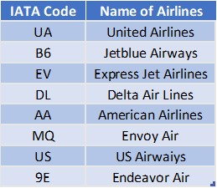
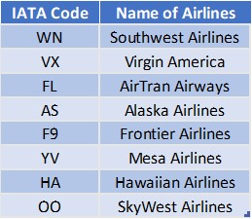
Appendix
Appendix I :
List of 16 carriers with regards to IATA (International Air Transport Association) coding:
https://www.kaggle.com/code/tejashreegaikar/flights-delay-prediction-final
Notes:
Speaker : Shubham

Slide 27
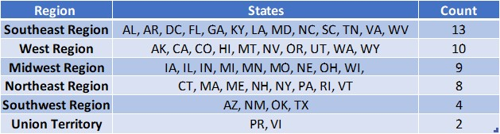
Appendix
Appendix II :
Our data has 3 airports as point of origins (EWR, LGA and JFK). However for destination, we have 106 airports.
In order to show a relation between carriers, point of origin along with destination airports, we categorized the airports based on the U.S state where they are situated.
However, this still gave us 46 values for destination. To reduce the number more, we further categorized the U.S States based on the geographical region. This narrowed the count to 6 destination regions.
Please find below the categorization:
Notes:
Speaker : Shubham

Slide 28
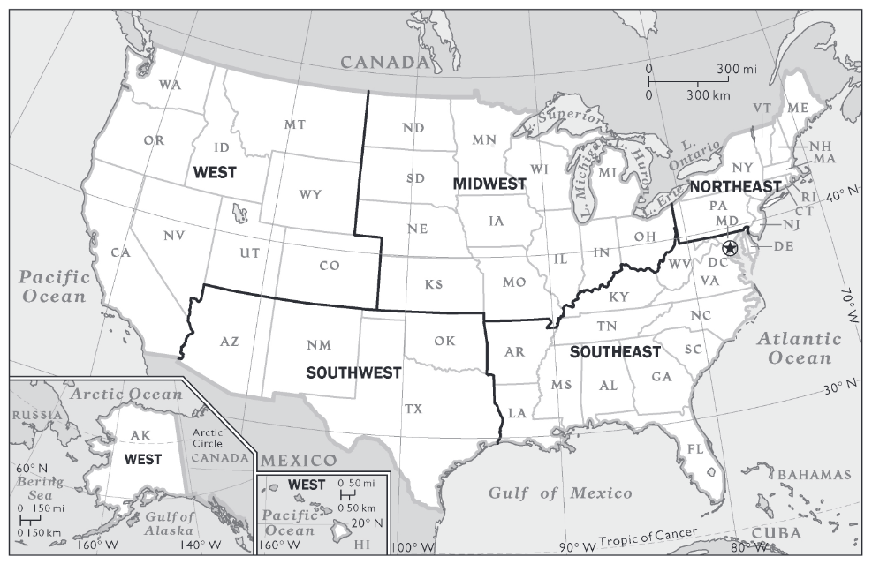
Appendix
Appendix III :
Map of U.S regions with state codes
Notes:
Speaker : Shubham

Slide 29
Thank You

